Slide 1

Advanced Corporate Finance (LL4554V/LL5554V/LLJ5554V/LL6554V) 12. mergers and acquisitions
Kenneth Khoo
kenneth.khoo@nus.edu.sg

Slide 2
Today’s Roadmap
Mergers and Acquisitions
Merger types and merger waves
Value-creating mergers: genuine sources of synergy
Value-redistributing mergers: who loses?
Value-destroying mergers: dubious motives
Estimating merger gains and costs
Mechanics: antitrust, form, and the law
Friendly vs hostile takeovers
Takeovers and the market for corporate control
Who gains and who loses from mergers?

Slide 3

What Is a Merger?
A merger occurs when one company (the acquirer) buys another (the target) and forms one combined firm
Terms used interchangeably: merger, acquisition, takeover
“Merger” often used when firms are similar in size
“Acquisition” or “takeover” when the acquirer is much larger
In 2022, there were roughly 50,000 M&A deals worldwide totaling $3.4 trillion
Mergers are typically the largest investment decisions a financial manager undertakes
Successful mergers can transform a company; unsuccessful ones can cripple it for a decade

Slide 4
Three Types of Mergers
Horizontal merger: two firms in the same line of business
Most common type — e.g., Microsoft/Activision Blizzard ($69B), AMD/Xilinx ($49B)
Vertical merger: firms in the same value chain at different stages of production
Expands backward toward raw materials or forward toward the consumer
Example: CVS Health acquired Aetna ($69B, 2018) — pharmacy + health insurance
Conglomerate merger: firms in unrelated lines of business
Popular in the 1960s–1970s; many were broken up in the 1980s–1990s
Example: India’s Tata Group (coffee, steel, cars, hotels, salt)

Slide 5
Merger Waves
Mergers come in waves — surges followed by quiet periods
Upsurges in the 1960s, late 1980s, 1990s, and 2003–2007
Waves generally coincide with periods of rising stock prices
Each wave tends to concentrate in a small number of industries, prompted by technology, regulation, or competitive shifts
Autos: shift to EVs → Fiat Chrysler + Peugeot = Stellantis (2021)
Semiconductors: rising fabrication costs → AMD acquired Xilinx ($49B, 2022)
Energy: rise of renewables → BP bought Lightsource Solar (2017); Total bought Saft batteries (2016)

Slide 6
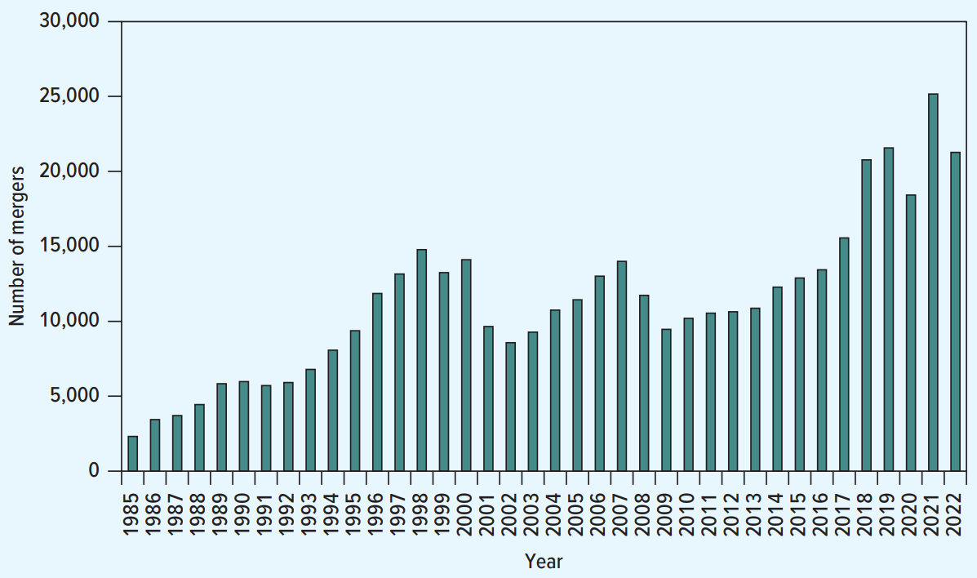
Merger Waves: North America 1985–2022
Number of deals fluctuates dramatically year to year
Peaks roughly around 2000 and 2015–2021
Activity tends to cluster in industries undergoing structural change
Driven by technology, deregulation, and competitive dynamics
Each wave has a different industrial composition

Slide 7

The Synergy Principle
A merger can only create value if the two firms are worth more together than apart
Synergies arise when the merged firm achieves outcomes that neither firm could achieve alone
The Synergy Principle: a merger only creates synergies if it achieves outcomes that the merging companies, or their shareholders, could not achieve themselves
The DIY Principle applies from two perspectives:
Shareholders’ perspective: buying a target to diversify or enter a growing industry doesn’t create value — shareholders can do this themselves
Companies’ perspective: a bank doesn’t need to own a computer manufacturer — it can buy computers from a supplier
Mergers are expensive (20–40% premium) — they should be a last resort

Slide 8
Economies of Scale
Value is created by conducting the same activity at a larger scale
Cost synergies: average unit cost falls as production increases
Spread fixed costs over larger volume
BB&T + SunTrust (2019): estimated $1.6B annual cost savings by 2022
Shared central services: office management, accounting, executive development
U.S. banking: restrictions on interstate banking left 14,000+ banks; consolidation reduced this to ~5,000
Study of 41 large bank mergers: PV of cost savings averaged 12% of combined market values (Houston et al. 2001)
Revenue synergies: a gym chain with more branches attracts more members because of convenience

Slide 9
Economies of Scope and Vertical Integration
Economies of scope: value from conducting a wider range of activities
Cross-selling: Amazon acquired Whole Foods (2017) — sell groceries online, market Prime in stores
But cross-selling is often possible without a merger (DIY Principle)
Example: British Airways partners with Avis for car rentals without owning it
Economies of vertical integration: control over the production chain
Merge with a supplier or customer when activities are highly interdependent
Inditex (Zara) acquired primary textile supplier Indipunt (2017)
Not always wise: GM spun off Delphi (1998) — found it cheaper to buy parts at arm’s length

Slide 10
Complementary Resources and Corporate Control
Complementary resources: each firm has what the other needs
Disney acquired Pixar (2006): Pixar’s animation expertise + Disney’s marketing and merchandising
Pharma firms acquiring biotech startups for pipeline drugs (e.g., Bristol Myers Squibb / IFM Therapeutics, 2017)
Changes in corporate control: replacing underperforming managers
Poorly run firms are natural takeover targets — new management can cut costs and improve operations
In the year after a takeover, the CEO is 4x more likely to be replaced
Acquired firms’ stock typically lagged their industry by 15% in the four years before acquisition
Replacing management via acquisition should be a last resort — board changes or proxy fights are cheaper

Slide 11
Synergy Potential Does Not Guarantee Success
Integrating two firms with different processes, accounting, and cultures is extremely complex
Mizuho Bank (Japan, 2002): three banks merged to form $1.5T bank
IT integration fiasco: 7,000 ATMs failed, 60,000 accounts double-debited, millions of bills unpaid
Three different IT systems connected via “relay” computers instead of unified system
Daimler-Chrysler (1998): hailed as a model auto merger
Cultural clashes: pay gaps (Americans earned 2–4x more), decision-making styles, expense norms
Daimler sold Chrysler to Cerberus (2007) and paid $677M to offload it
Human assets go down in the elevator every night — unhappy employees will leave and never return

Slide 12

Value-Redistributing Mergers
These mergers do not grow the pie — shareholders gain at the expense of other stakeholders
Customers: reduced competition → higher prices, less choice, lower service
5–7% of pharma acquisitions are “killer acquisitions” — buy the target solely to shut down its innovation
Suppliers: merged firm has greater bargaining power → lower prices to suppliers
Employees: less competition may allow lower wages; plant closures cause job losses
Bondholders: if the acquirer finances the merger with more debt, existing bondholders may lose
Government: debt-financed mergers generate tax shields; tax inversions shift domicile to lower-tax countries
Pfizer/Allergan ($160B, 2015): would have saved $1B/year in taxes — abandoned after new U.S. regulations

Slide 13
Value-Destroying Mergers: Deploying Surplus Cash
A mature company with surplus cash may buy a target in a growing industry
Rationale: “Put the spare cash to good use in a fast-growing sector”
But paying out cash via dividends or buybacks is better — shareholders can invest it themselves (DIY Principle)
Example: HP acquired Autonomy ($11.1B, 2011)
HP had surplus cash and wanted to become a software/services company
Accounting irregularities + poor strategic rationale → HP wrote down $8.8B
Dubious motives for merger that often destroy value:
Deploying surplus cash, boosting EPS, lowering borrowing costs, and management motives

Slide 14
The EPS Accretion/Dilution Trap
Investment bankers often analyze whether a merger is accretive or dilutive to EPS
A company can increase EPS by buying a target with a lower P/E ratio — even with zero synergies
Prestige Pharma (P/E = 20) acquires Common Chemicals (P/E = 10):
Prestige: 100,000 shares, EPS = $2.00, price = $40
Common: 100,000 shares, EPS = $2.00, price = $20
Prestige issues 50,000 new shares to buy all of Common
Merged: 150,000 shares, earnings = $400,000, EPS = $2.67 (up from $2.00!)
But the stock price is unchanged at $40 — the P/E ratio falls from 20 to 15

Slide 15
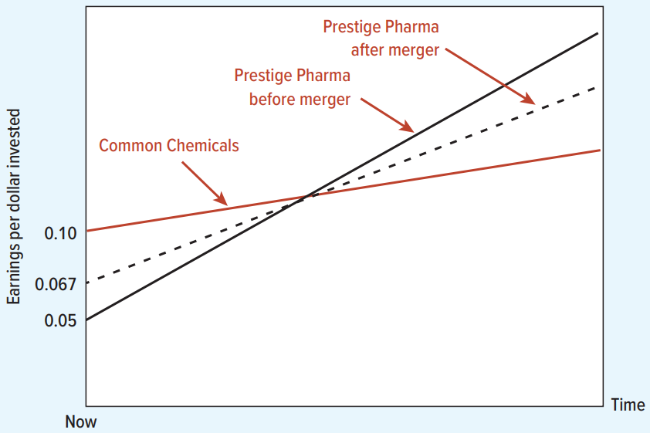
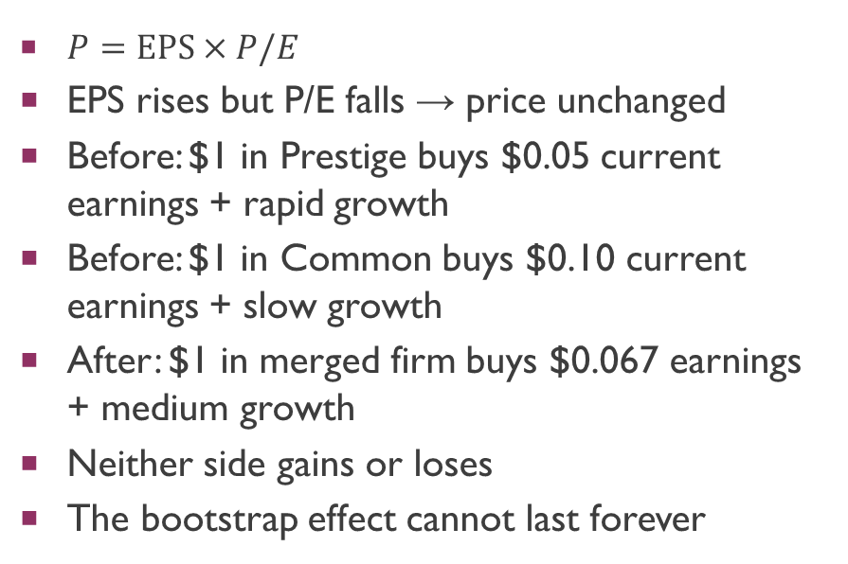
Why Higher EPS Does Not Mean Higher Price
$P=\text{EPS}×P/E$
EPS rises but P/E falls → price unchanged
Before: $1 in Prestige buys $0.05 current earnings + rapid growth
Before: $1 in Common buys $0.10 current earnings + slow growth
After: $1 in merged firm buys $0.067 earnings + medium growth
Neither side gains or loses
The bootstrap effect cannot last forever

Slide 16
Lower Borrowing Costs: Not a Valid Reason
Diversification reduces firm risk → bondholders accept a lower interest rate
Example: Izy’s Ice Cream + Ursula’s Umbrellas
Separately: each worth $10 or $12 (sun/rain), each borrows $10M at 10% promised rate
Merged: always worth $22 (no risk), borrows $20M at 5% promised rate
Seems like shareholders win? No — shareholders still receive $1M in both states
The 10% promised rate was not the true cost — lenders got paid in full only half the time
True expected return was 5% both before and after the merger
Diversification means each firm guarantees the other’s debt — a gift to bondholders, not to shareholders

Slide 17
When Financial Synergies May Be Valid
While lower borrowing costs per se don’t create value, related reasons may:
Bankruptcy costs: if bankruptcy is costly, reducing its probability creates real value
The merged firm never defaults in the Izy/Ursula example, avoiding deadweight costs
Tax shields: the merged firm can take on more debt without bankruptcy risk
Merged firm can borrow up to $22/1.05 = $20.95M vs. individual firms capped at $10/1.10 = $9.09M each
More debt = more interest tax shields
Issue costs: economies of scale in making fewer, larger debt issues
These are “icing on the cake” — they rarely justify the 20–40% acquisition premium on their own

Slide 18
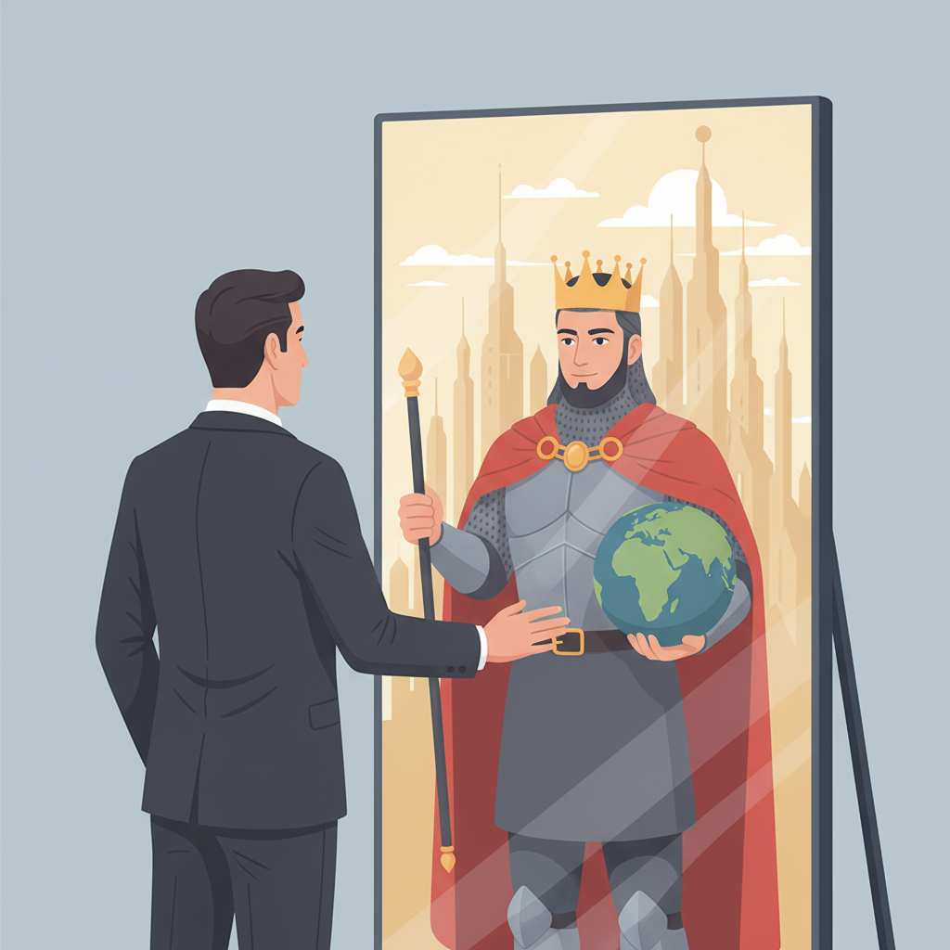
Management Motives for Mergers
Size: CEOs enjoy more pay and prestige from running larger firms
Pay: ~40% of acquiring firms give CEOs a cash bonus just for completing the deal (Grinstein & Hribar 2004)
Vodafone CEO: £10M for buying Mannesmann; Chase CEO: $20M bonus for buying J.P. Morgan
Private benefits: managers may merge to enter an exciting sector or acquire people they admire
Block (Square) bought Tidal — critics argued the motive was for Jack Dorsey to work with Jay-Z
Diversification: does not help shareholders, but reduces the CEO’s personal risk of being fired
Overconfidence (hubris): CEOs lauded in the media make more frequent acquisitions at higher premiums
Warren Buffett: “Many managerial princesses remain confident about the potency of their kisses — even after their backyards are knee-deep in unresponsive toads”

Slide 19
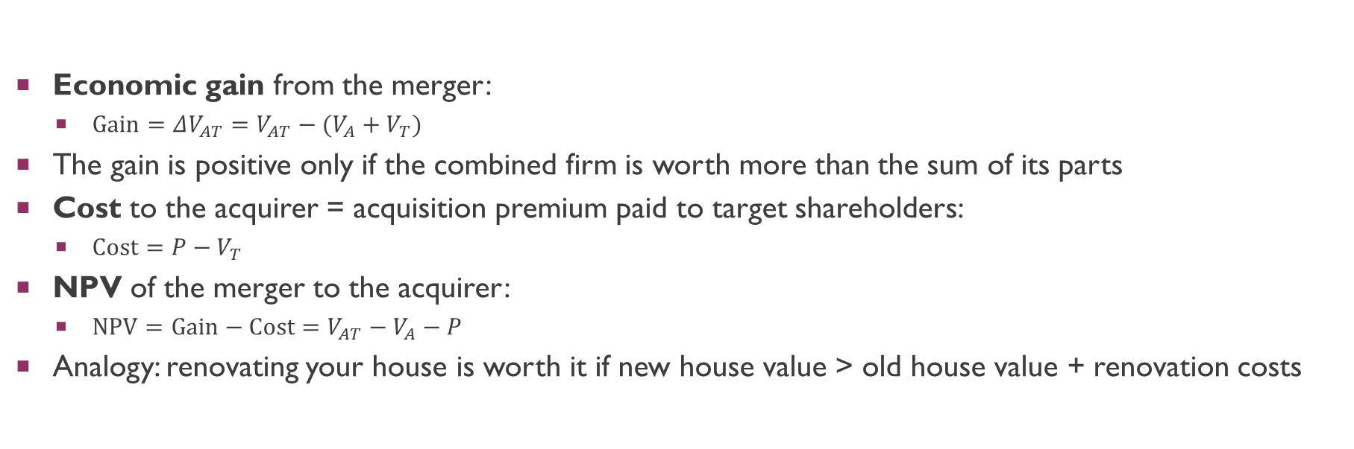
Estimating Merger Gains and Costs
Economic gain from the merger:
$\text{Gain}=ΔV_{AT}=V_{AT}−(V_{A}+V_{T})$
The gain is positive only if the combined firm is worth more than the sum of its parts
Cost to the acquirer = acquisition premium paid to target shareholders:
$\text{Cost}=P−V_{T}$
NPV of the merger to the acquirer:
$\text{NPV}=\text{Gain}−\text{Cost}=V_{AT}−V_{A}−P$
Analogy: renovating your house is worth it if new house value > old house value + renovation costs

Slide 20
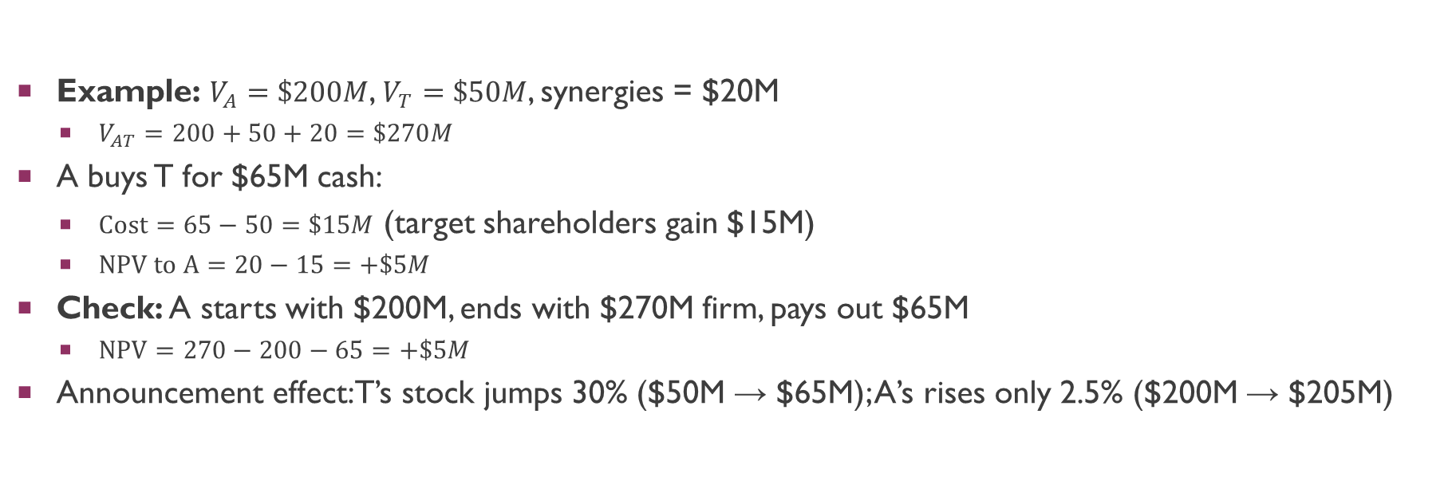
NPV When the Merger Is Financed by Cash
Example: $V_{A}=\$200M$, $V_{T}=\$50M$, synergies = $20M
$V_{AT}=200+50+20=\$270M$
A buys T for $65M cash:
$\text{Cost}=65−50=\$15M$ (target shareholders gain $15M)
$\text{NPV} \text{to} \text{A}=20−15=+\$5M$
Check: A starts with $200M, ends with $270M firm, pays out $65M
$\text{NPV}=270−200−65=+\$5M$
Announcement effect: T’s stock jumps 30% ($50M → $65M); A’s rises only 2.5% ($200M → $205M)

Slide 21
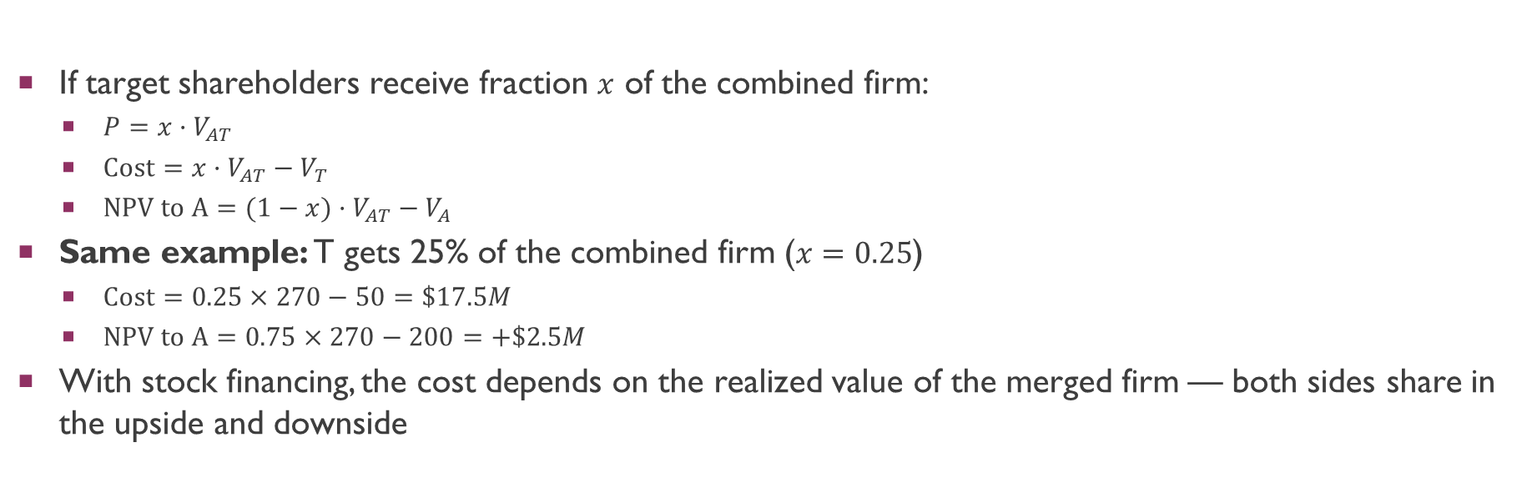
NPV When the Merger Is Financed by Stock
If target shareholders receive fraction $x$ of the combined firm:
$P=x·V_{AT}$
$\text{Cost}=x·V_{AT}−V_{T}$
$\text{NPV} \text{to} \text{A}=(1−x)·V_{AT}−V_{A}$
Same example: T gets 25% of the combined firm ($x=0.25$)
$\text{Cost}=0.25×270−50=\$17.5M$
$\text{NPV} \text{to} \text{A}=0.75×270−200=+\$2.5M$
With stock financing, the cost depends on the realized value of the merged firm — both sides share in the upside and downside

Slide 22
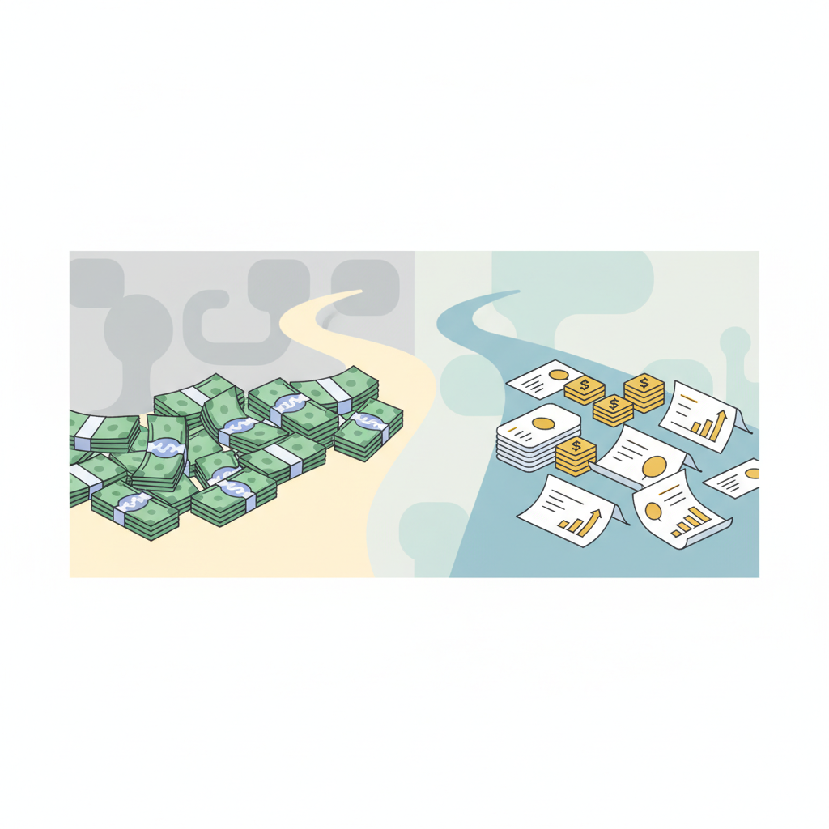
Cash vs. Stock: What Determines Method of Payment?
Trade-off theory factors: cash (= more debt) is more likely when there are more profits to shield and lower bankruptcy/agency costs
Asymmetric information over acquirer’s standalone value:
If A’s managers think their stock is overvalued, they prefer stock financing (pecking order logic)
Asymmetric information over synergies:
If A’s managers expect large synergies, shares in the merged firm are worth more → prefer cash
Stock financing signals that the acquirer is pessimistic about synergies or its own value
Empirical evidence: stock-financed deals see acquirer stock fall ~1.5% on announcement
Cash deals see a small gain of ~0.4%

Slide 23
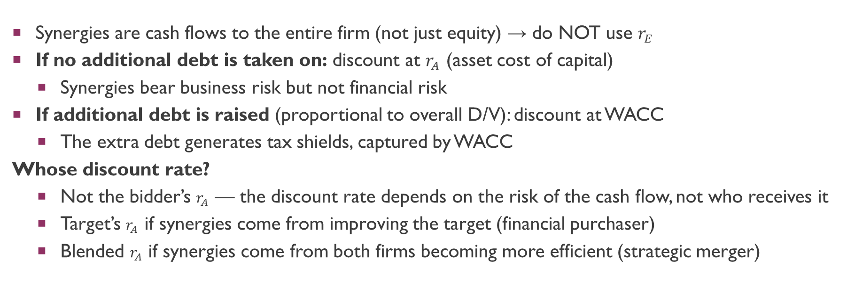
Valuing Synergies: Which Discount Rate?
Synergies are cash flows to the entire firm (not just equity) → do NOT use $r_{E}$
If no additional debt is taken on: discount at $r_{A}$ (asset cost of capital)
Synergies bear business risk but not financial risk
If additional debt is raised (proportional to overall D/V): discount at WACC
The extra debt generates tax shields, captured by WACC
Whose discount rate?
Not the bidder’s $r_{A}$ — the discount rate depends on the risk of the cash flow, not who receives it
Target’s $r_{A}$ if synergies come from improving the target (financial purchaser)
Blended $r_{A}$ if synergies come from both firms becoming more efficient (strategic merger)

Slide 24
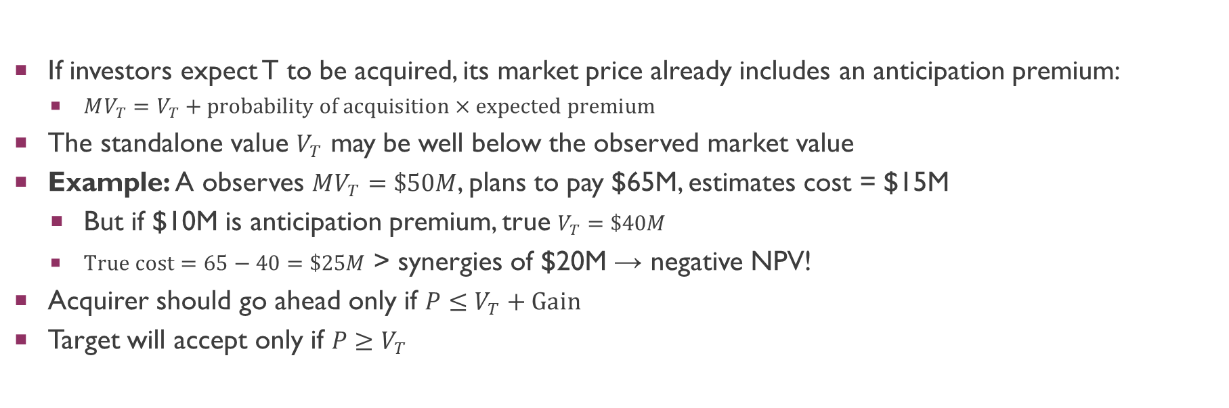
Watch Out for the Anticipation Premium
If investors expect T to be acquired, its market price already includes an anticipation premium:
$MV_{T}=V_{T}+\text{probability} \text{of} \text{acquisition}×\text{expected} \text{premium}$
The standalone value $V_{T}$ may be well below the observed market value
Example: A observes $MV_{T}=\$50M$, plans to pay $65M, estimates cost = $15M
But if $10M is anticipation premium, true $V_{T}=\$40M$
$\text{True} \text{cost}=65−40=\$25M$ > synergies of $20M → negative NPV!
Acquirer should go ahead only if $P≤V_{T}+\text{Gain}$
Target will accept only if $P≥V_{T}$

Slide 25

Antitrust and Regulatory Barriers
Clayton Act (1914): forbids acquisitions that may substantially lessen competition or create a monopoly
Enforced by the Justice Department or the Federal Trade Commission (FTC)
Hart-Scott-Rodino Act (1976): acquisitions > ~$75M must be reported to these agencies in advance
Examples of blocked/modified deals:
Penguin Random House / Simon & Schuster ($2.2B, 2022) — blocked (harm to competition in publishing rights)
United Technologies / Raytheon (2020) — approved only after divesting military radios and GPS businesses
Booking Holdings / eTraveli (€1.63B, 2023) — blocked by EU (dominant position in hotel bookings)
CFIUS reviews foreign acquisitions for U.S. national security (e.g., blocked Broadcom/Qualcomm, 2018)
Similar considerations for SG under s 54 of the Competition Act.

Slide 26
The Form of Acquisition (The US / Delaware Model)
Assuming a friendly board (more on hostile takeovers later):
Statutory (One-Step) Merger (DGCL 251):The acquirer buys the entire target and merges it with itself or a subsidiary.
Mechanics: Automatically assumes all of the target’s assets and liabilities.
Approval: Requires approval of the target’s board and at least 50% of the target’s shareholders + SEC proxy review process. Dissenting shareholders are bound but may seek appraisal rights in court. Note: Shareholder meeting is required.
Two-Step Takeover (Tender Offer + Back-End Merger):
Step 1 (Tender Offer): Acquirer and target board sign a merger agreement; acquirer makes a tender offer directly to shareholders. Shareholders decide whether to sell.
Step 2 (The Back-End Merger): Under DGCL 251(h), if the acquirer successfully tenders at least 50% of the shares, they can immediately execute a “short-form” merger to squeeze out the remaining minority without a shareholder vote. Note: No shareholder meeting is required.
Advantage: Much faster than a one-step statutory merger because you bypass the SEC proxy review process and the months-long wait for a shareholder meeting. (Note: If this is a controller buyout, MFW/SB 21 safe harbors apply)
Acquisition of Assets: Buy some or all of the target’s assets (e.g., a division). Payment goes to the target company, not its shareholders.
Notes:
Partial offers not discussed here.

Slide 27
The Form of Acquisition (The SG/UK Model)
Assuming a friendly board (more on hostile takeovers later):
Scheme of Arrangement (The “One-Step” Acquisition):
A court-sanctioned legal process where the acquirer buys 100% of the target's shares.
Approval: Requires approval by a "majority in number representing 75% in value" of shareholders present and voting.
Mechanics: Must be sanctioned by the Courts. Once sanctioned, it legally binds all dissenting minority shareholders.
General Offer & Squeeze-Out (The “Two-Step” Takeover):
Step 1 (General Offer): Acquirer makes a direct offer to target shareholders to buy their shares under the Takeover Code.
Step 2 (The Squeeze-Out): Under Section 215 of the Companies Act, if the acquirer receives acceptances for at least 90% of the target's shares (excluding their initial stake), they can legally compel the remaining minority to sell.
The Friction Point: If the acquirer gains majority control (e.g., 60%) but falls short of 90%, they cannot force a merger; the minority shareholders remain indefinitely.
Acquisition of Assets: Buy some or all of the target's underlying assets/business. Economic structure similar to the US, but major asset sales in SG are heavily regulated by listing rules (e.g., SGX requirements for “major transactions”).
Notes:
Partial offers not discussed here.

Slide 28
The Market for Corporate Control
The market for corporate control: mechanisms that match firms with the best owners and managers
Ownership Structure & Agency Costs:
The US Model: Dispersed ownership creates a primary conflict between Managers vs. Shareholders.
The SG/Asia Model: Concentrated ownership (e.g., family blocks or state control) creates a primary conflict between Controlling Shareholders vs. Minority Shareholders.
Mechanisms to Change Management:
Shareholder Voting:
US Approach: Proxy Contests. Shareholders wage expensive campaigns to vote in a new board, typically waiting for the annual meeting.
SG/UK Approach: EGM Requisitions. Shareholders holding a minority stake (e.g., 10%) can force an Extraordinary General Meeting at any time to remove directors via a simple ordinary resolution.
Takeovers: Another company acquires the firm.
Leveraged Buyouts (LBO): Private investors buy the firm (covered in Ch. 33).

Slide 29
The Market for Corporate Control
Friendly Takeover: Target management advises shareholders to accept the acquirer's bid.
Hostile Takeover: Target management actively fights the bid.
Why Hostile Bids are Expensive (A Jurisdictional Divide)
In the US (Delaware Law): Hostile bids are expensive due to legal costs. Acquirers must spend years in court fighting board-level defenses like the poison pill and staggered boards.
In Singapore & the UK: Hostile bids are expensive due to capital costs (takeover premiums).
Because the Takeover Code legally restricts the board from deploying poison pills, litigation is rare.
Instead, the acquirer must offer an overwhelmingly attractive premium directly to the institutional shareholders to secure control, which often triggers the costly requirement to make a Mandatory Offer for all remaining shares.

Slide 30

Takeover Defenses: US vs. Singapore/UK
The US Approach (Board-Centric Defenses)
Shark-Repellent Amendments: Supermajority voting (e.g., 80% approval required), fair price formulas, or restricted voting rights for large blockholders.
The Poison Pill: Existing shareholders get rights to buy shares at a steep discount if a bidder acquires a significant stake.
Result: The bidder is excluded, and their control is massively diluted. Can be deployed quickly as a “morning-after pill.”
Other Defenses: Asset restructuring (selling the “crown jewels”) or liability restructuring (issuing shares to a friendly “white knight”).

Slide 31
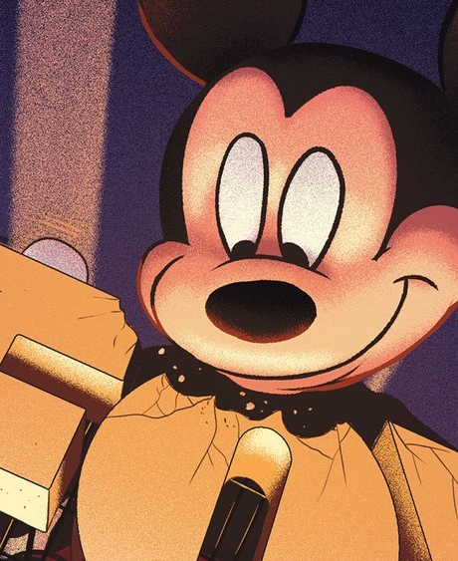
Takeover Defenses: US vs. Singapore/UK
The Singapore/UK Approach (Shareholder-Centric Code)
Takeover defenses are functionally absent. The Takeover Code strictly prohibits the board from taking any "frustrating actions" to block a bona fide bid without shareholder approval.
The Main Barrier: The Mandatory Bid Rule. If an acquirer crosses the control threshold (30% of voting rights), they are legally obligated to make a mandatory cash offer to buy out all remaining shareholders.
The offer must be at the highest price the acquirer paid in the preceding months.
Effect: Prevents “creeping takeovers.” Acquirers cannot grab control on the cheap; they must have the massive capital required to buy the entire company at a premium.
This Photo by Unknown Author is licensed under CC BY-SA-NC

Slide 32
The US Approach (Board Primacy & Judicial Review)
Management Conflicts: Managers may oppose bids to hold out for a better price, or to protect their own jobs.
Example: Golden parachutes compensate departing executives (Yahoo!’s Marissa Mayer: $23M parachute in 2017).
The Role of the Courts (Delaware Law): Because boards have the power to block deals, courts must heavily scrutinize their actions.
Unocal (1985): Board must fully inform itself; defensive measures must be “reasonable and proportionate” to the threat.
Revlon (1985): Once the sale of the company is inevitable, the board's duty shifts strictly to obtaining the best value reasonably available for shareholders.
Paramount (1993): Court blocked the Viacom deal because the board failed to consider QVC’s higher offer.
Early Warning System: Williams Act (1968)—Holders of 5%+ must file Schedule 13(d) disclosing their stake and intentions. This often invites competing bidders and raises the takeover premium.

Slide 33
The Singapore/UK Approach (Shareholder Primacy & The Code)
Management Conflicts: The Takeover Code explicitly assumes managers have a conflict of interest during a bid.
“No Frustration Rule”: Unlike the US, the board is strictly prohibited from taking actions that could defeat a bona fide bid (e.g., issuing shares, selling major assets) without direct shareholder approval.
The Role of the Board (Advisors, not Gatekeepers):
The Proper Purpose Rule: Directors cannot exercise their powers (e.g., issuing shares to a white knight) for the primary purpose of thwarting a takeover or manipulating voting power (Howard Smith v Ampol). They are forbidden from doing this even if they genuinely believe defeating the raider is in the company's best interest.
Advisory Duty: Instead of blocking bids, the board’s main duty is to advise. They must appoint an Independent Financial Adviser (IFA) to evaluate the offer so shareholders can make an informed decision.
Early Warning & Transparency: Substantial Shareholding and Deal Disclosures
Similar to the US, crossing the 5% threshold triggers mandatory disclosure (under the SG Securities and Futures Act).
The Offer Period: Once a bid is announced, the Code enforces extremely strict, daily public disclosures of any stock dealings by the bidder, the target, or their associates, ensuring complete market transparency

Slide 34
Who Gains and Loses? Shareholder Returns
Target shareholders: average abnormal return of ~18% around the announcement
Even higher in cash-financed deals
Some extreme cases: Allergan paid a 500% premium for Tobira (2016)
Acquirer shareholders: average return ~0.5% — slightly better than break even
Higher in cash-financed deals than stock-financed deals
Combined gains: merging firms’ value increased by ~1.1% on average (1980–2005)
Analyst forecasts suggest merger gains come primarily from operating synergies — especially reductions in capex and working capital, not from revenue increases or cost cuts

Slide 35
Why Buyers Earn Lower Returns Than Sellers
1. Size effect: buyers are typically much larger — even large dollar gains are small percentage returns
If T is 1/10th of A’s size and gains are split equally, T gets 10x A’s percentage return
2. Competition among bidders: once T is “in play,” rival bidders (or white knights) force up the premium
3. Value destruction: hubris and self-interest lead some managers to overpay
Aggressive acquirers in 1998–2001 produced large losses (Moeller et al. 2005)
4. Investment bank incentives: banks earn fees for doing deals, not for creating value
League table rankings depend on deal count and size, not on value creation
Study found bank market share unrelated to value creation in past deals (Bao & Edmans 2011)

Slide 36

High-Profile Merger Disasters
AT&T / Time Warner ($85.4B, 2018):
Goal: integrate media content with telecom services
Synergies never materialized; AT&T struggled to manage a combined telecom + media company
AT&T spun off WarnerMedia and merged it with Discovery in 2021
Kraft / Heinz ($46B, 2015):
Difficulties integrating operations and cutting costs
Subsequent acquisitions (Primal Kitchens, Nutrish) also failed to generate synergies
Daimler / Chrysler ($38B, 1998): cultural clashes; Daimler paid Cerberus to take Chrysler (2007)
HP / Autonomy ($11.1B, 2011): accounting irregularities; $8.8B write-down

Slide 37
Do Stakeholders Lose from Mergers?
Evidence suggests stakeholder losses are limited:
Customers: competitor stock prices are unchanged or fall — inconsistent with reduced competition
Corporate customers’ stock prices rise, suggesting they share in synergies
Suppliers: retained suppliers gain; non-retained suppliers lose → procurement becomes more efficient
Employees: wages and employment appear to rise after mergers (Brown & Medoff 1988)
Consistent with mergers improving firm viability and sharing gains with workers
Taxpayers: tax plays a minor or zero role in most mergers (Auerbach & Reishus 1987)
Bondholders: mixed evidence; target’s bonds tend to appreciate (now part of a larger firm)

Slide 38
Summary: Categories of Mergers
Value-Creating
Value-Destroying
Genuine synergies:
Economies of scale/scope
Vertical integration
Complementary resources
Improved corporate control
Grow the pie for all parties
Must pass the DIY test
Must justify the 20–40% premium
Dubious motives:
Surplus cash deployment
EPS bootstrap effect
Lower borrowing costs
Hubris and empire-building
Shrink the pie
Often driven by management incentives
Market eventually sees through tricks

